Slide 1
Title of presentation SUBTITLE
Prof. Artur Hugo Świergiel, Ph.D. Director of the Institute

Slide 2
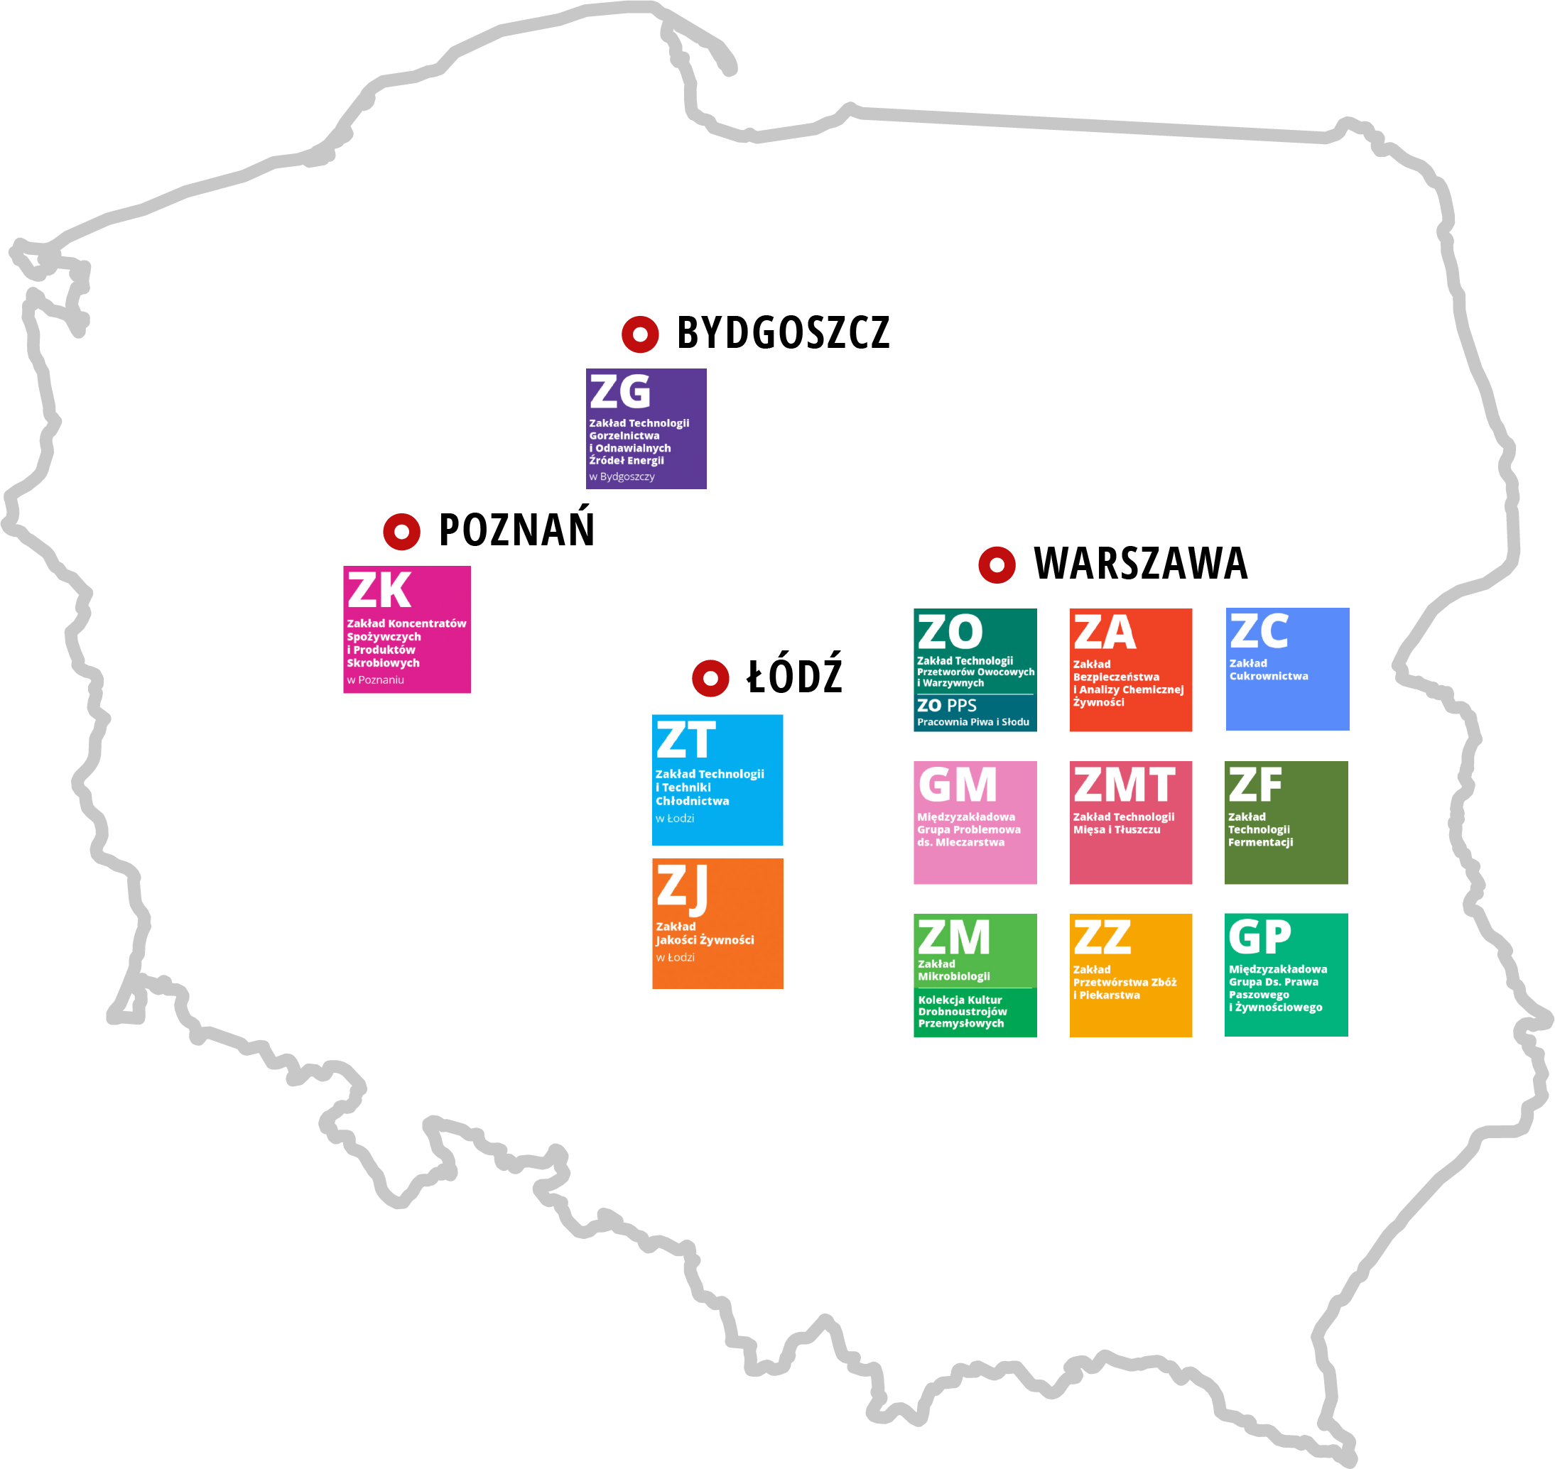
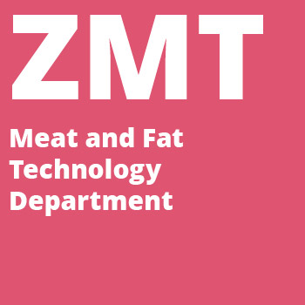
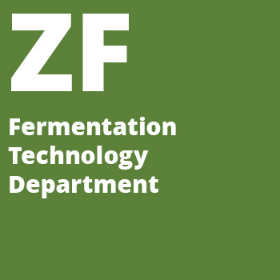
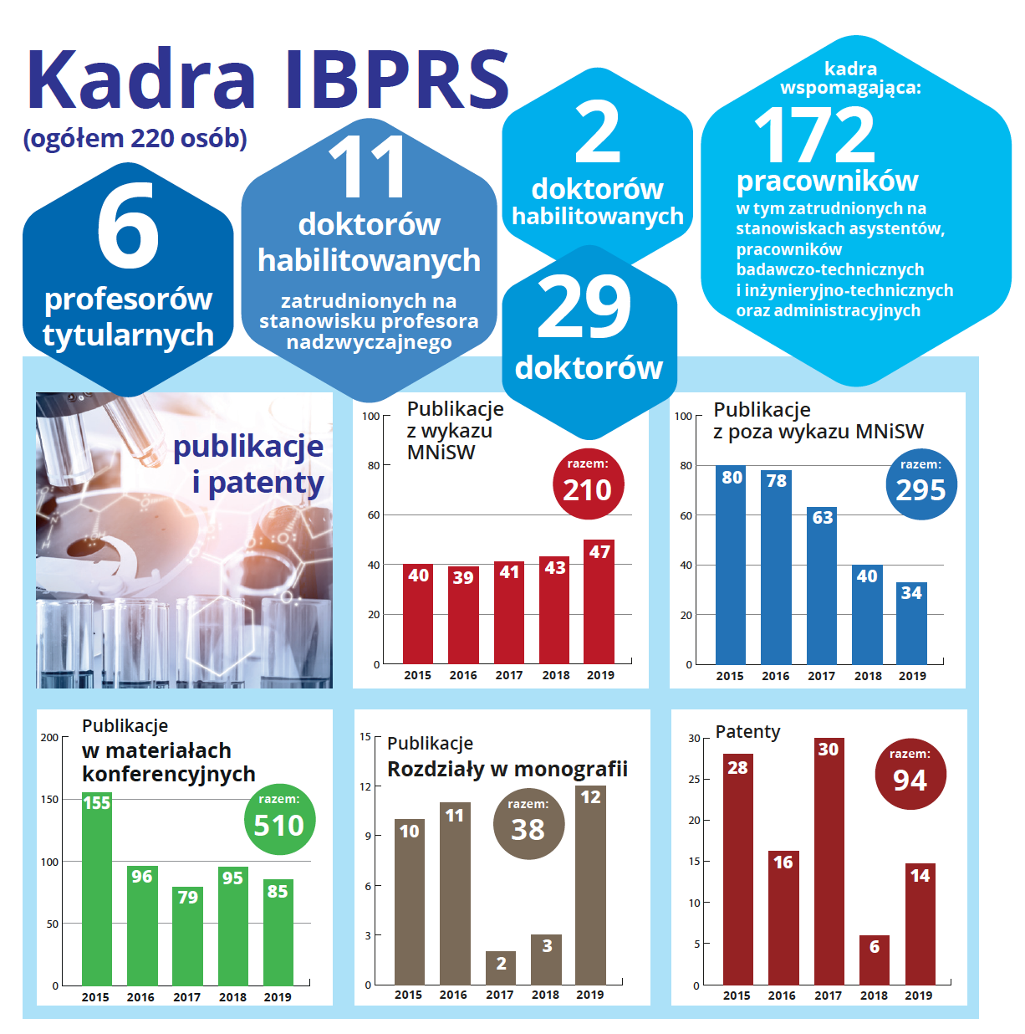
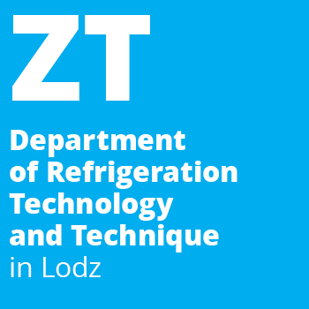
Locations:
Departments in Warsaw:
Food Analysis
Fermentation Technology
Department of Microbiology
Laboratory of Biotechnology and Molecular Engineering
Inter-department Group for Feed and Food Law
Fruit and Vegetable Product Technology
Grain Processing and Bakery
Meat and Fat Technology
Sugar Department
Department in Bydgoszcz:
Distillery and Renevable Energy Department
Departments in Łódź:
Department of Food Quality
Department of Refrigeration Technology and Technique
Department in Poznań:
Food Concentrates and Starch Products

Slide 3
Prof. Waclaw Dabrowski Institute of Agriculture and Food Biotechnology – State Research Institute was founded in 1949 in Warsaw as the Main Institute of Agricultural and Food Industry. Having changed its name several times, last one given in 2012 before the incorporation into its structures of two other institutes with a long tradition: The Institute of Meat and Fat Industries and the Sugar Industry Institute, as well as several other research laboratories. Currently, the institute consists of 12 departments equipped with modern laboratories and using more than 600 accredited research methods.
The main task of the Institute is to conduct basic and applied research in the field of agri-food biotechnology, safe food production and storage, supporting agri-food industry and carrying out activities aimed at improving the quality of people’s life. The Institute cooperates with industrial partners from various areas of the agri-food sector and related sectors, including environmental protection, renewable energy and refrigeration.
The Institute employs over 200 employees, including three titular professors, nine associate professors and 33 PhD researchers.
Prof. Wacław Dąbrowski Institute of Agriculture and Food Biotechnology – State Research Institute conducts scientific, development and implementation work in the field of biotechnology and agri-food technology. These works, of final application type, encompass many disciplines, such as:
technical microbiology and food microbiology, cellular engineering, process engineering, chemistry and biochemistry, food technology, human nutrition and dietetics. The Institute’s fields of activity also include many sectors of the agri-food industry: yeast industry, spirit distillation, viticulture, vinegar production, beer brewing, fruit and vegetable processing, cereal processing and storage, potato and starch processing, bakery and confectionery, food concentrates, frozen and chilled food, sugar production, meat and fat processing, and the production of microbiological preparations (enzymatic, probiotic, starter cultures and others)
Research areas – key words:
food safety, food analysis, food quality, biodiversity, functional food, food concentrates, renewable energy sources, starch products, fermentation technology, meat and fat industry, fruits, vegetables, cereal processing, bakery, distillers, refrigeration, sugar industry, microbiology, dairy industry, collection of cultures.

